Slide 1
High Performance Ray Tracing
Keqing Chen
Yihan Sun
Xinran Xu

Slide 2
Overview
Ray tracing: a popular rendering method
Traditional algorithms: only handle static scenes
Still images, film, television visual effects
More poorly suited for real-time applications like video games
In recent years, some techniques have been presented to handle deformable scenes
Specially-designed data structure
BVH, kd-tree
Using parallel methods

Slide 3
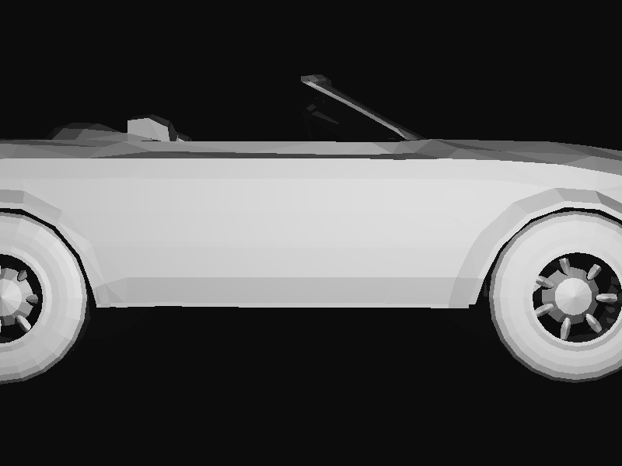
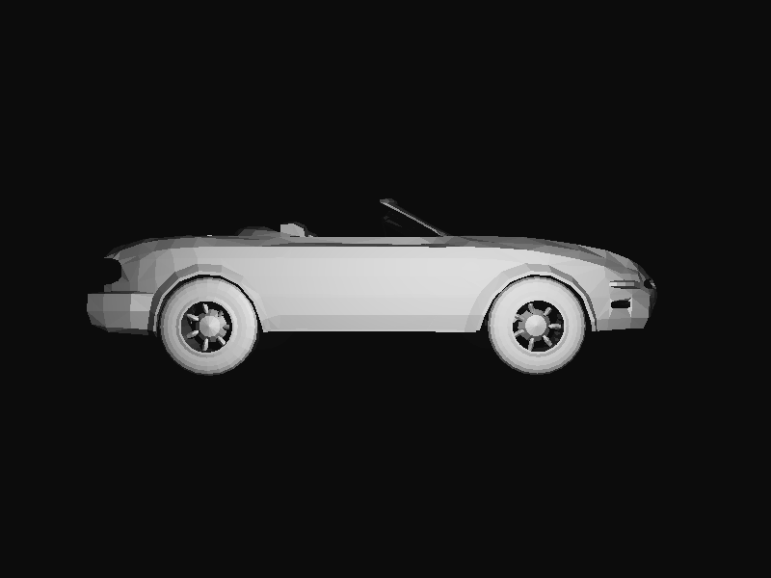
Result

Slide 4
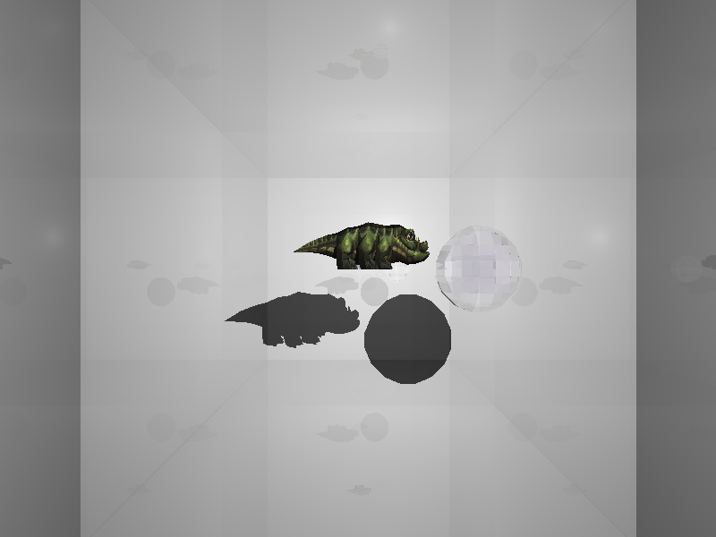
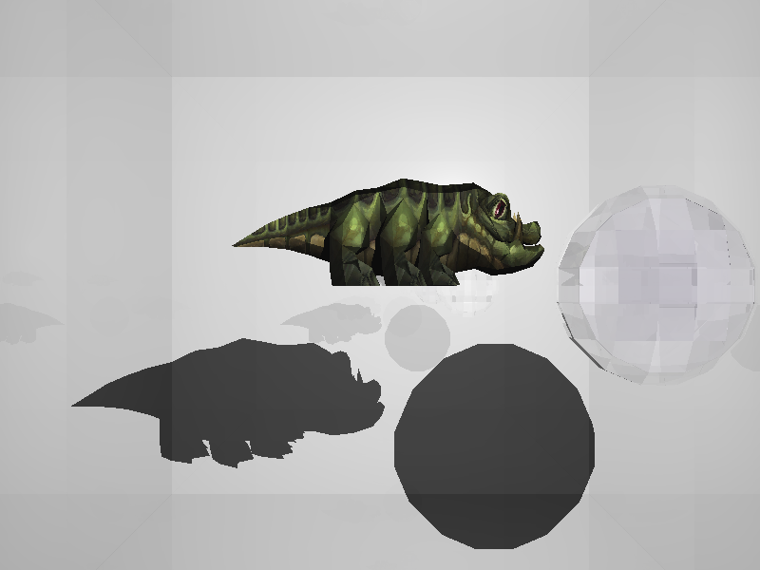
Result

Slide 5
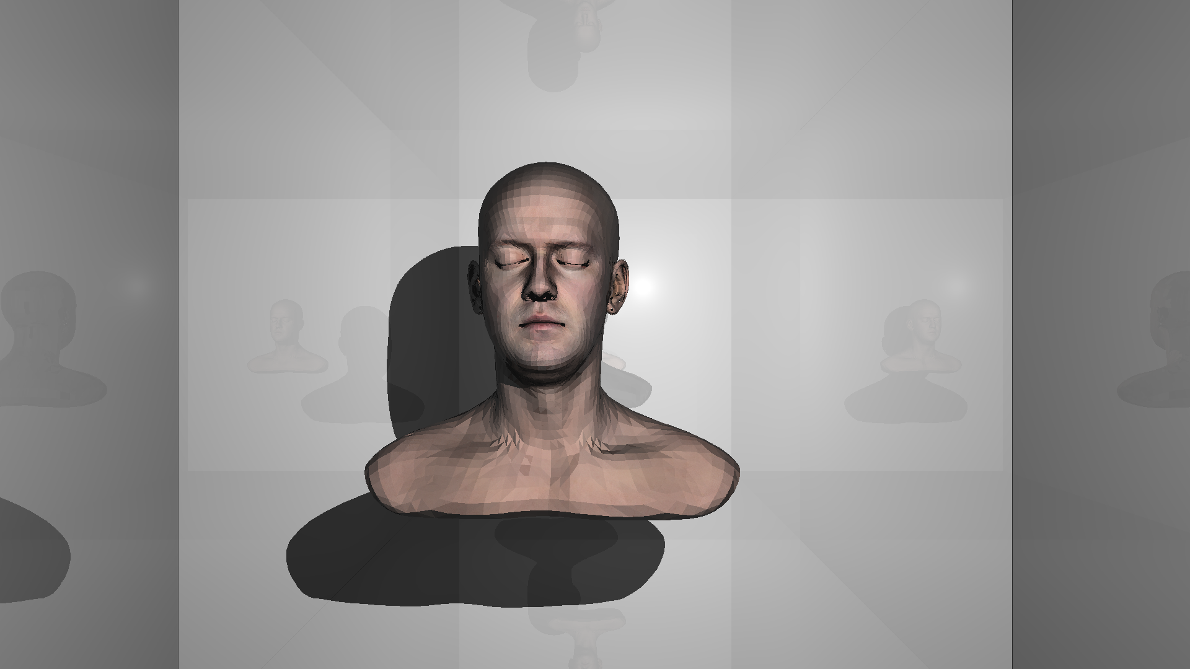
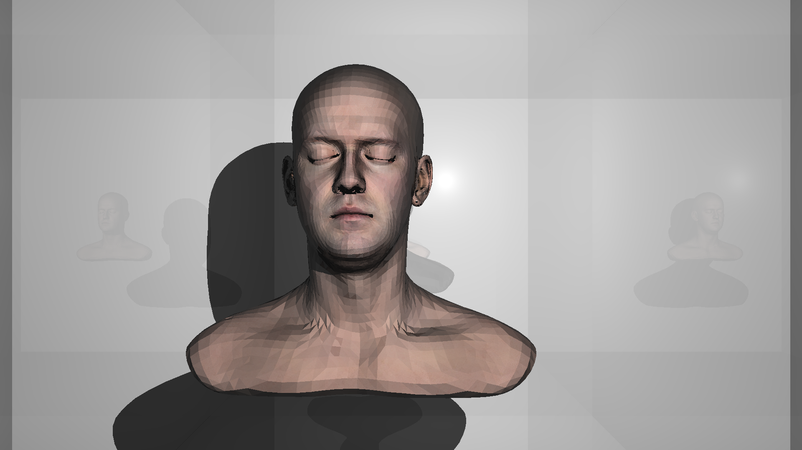
Result

Slide 6
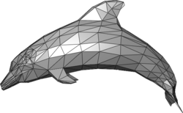
Triangle Mesh
A collection of vertices, edges and faces that defines the shape of a polyhedral object in 3D computer graphics and solid modeling
The faces usually consist of triangles, quadrilaterals or other simple convex polygons
We use polygon meshes only consisting of triangles

Slide 7
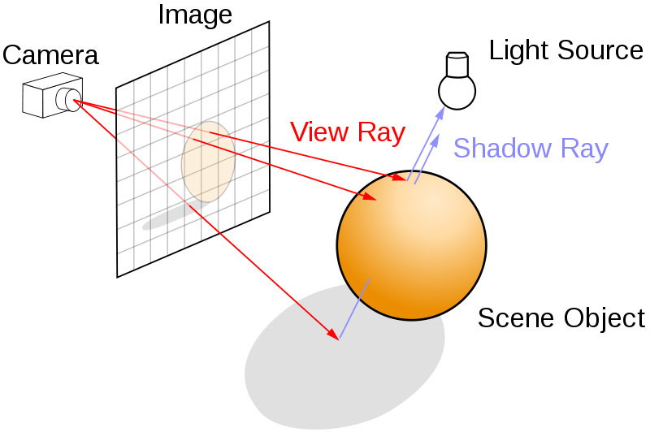
Ray Tracing - Algorithm
Tracing a path from an imaginary eye through each pixel in a virtual screen, and calculating the color of the object visible through it

Slide 8
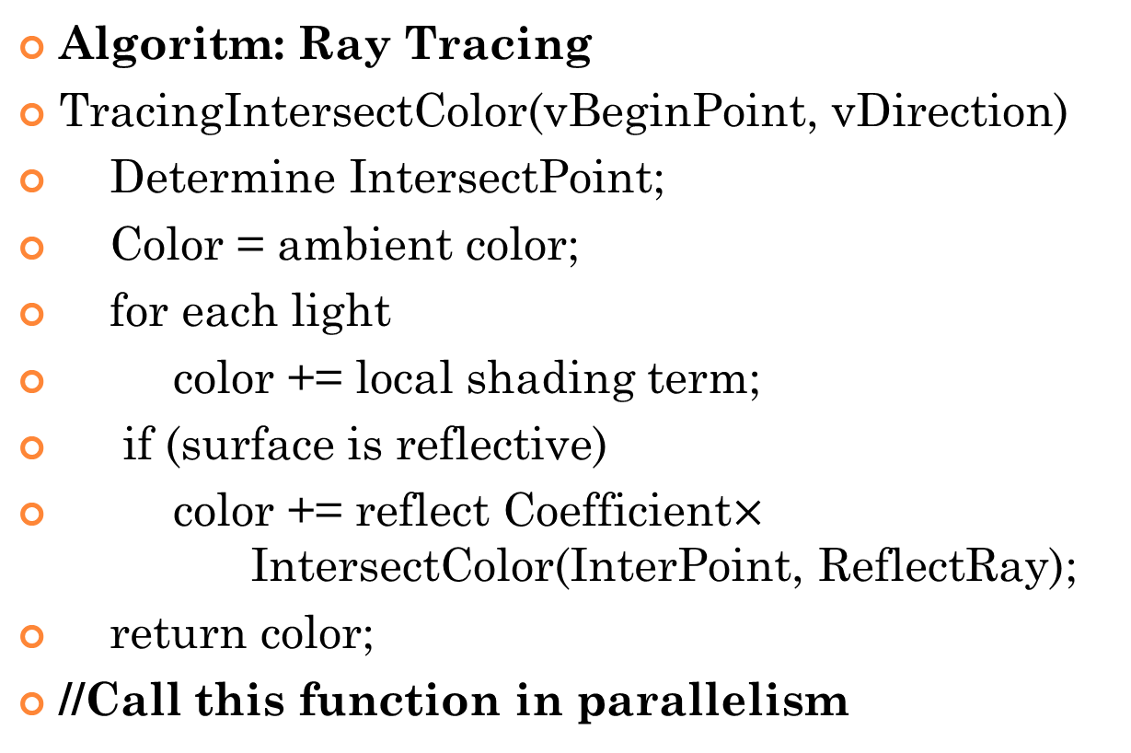
Ray Tracing - Algorithm
Algoritm: Ray Tracing
TracingIntersectColor(vBeginPoint, vDirection)
Determine IntersectPoint;
Color = ambient color;
for each light
color += local shading term;
if (surface is reflective)
color += reflect Coefficient$×$IntersectColor(InterPoint, ReflectRay);
return color;
//Call this function in parallelism

Slide 9
Bounding Volume Hierarchy (BVH)
A tree structure on a set of geometric objects
All geometric objects are wrapped in bounding volumes that form the leaf nodes of the tree
Build it recursively and update the bound of each node
As long as there are more than one triangle in it, we will split it
Calculate the bound of each node by combining its two sub-nodes

Slide 10
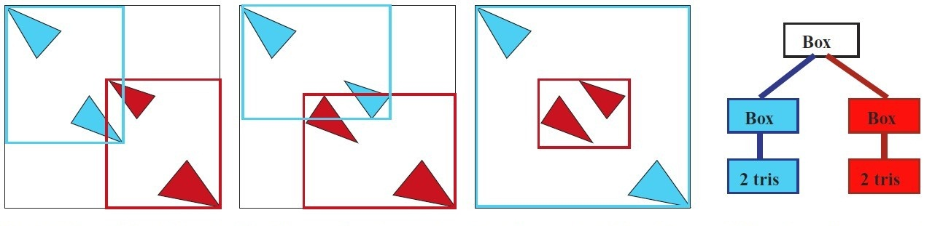
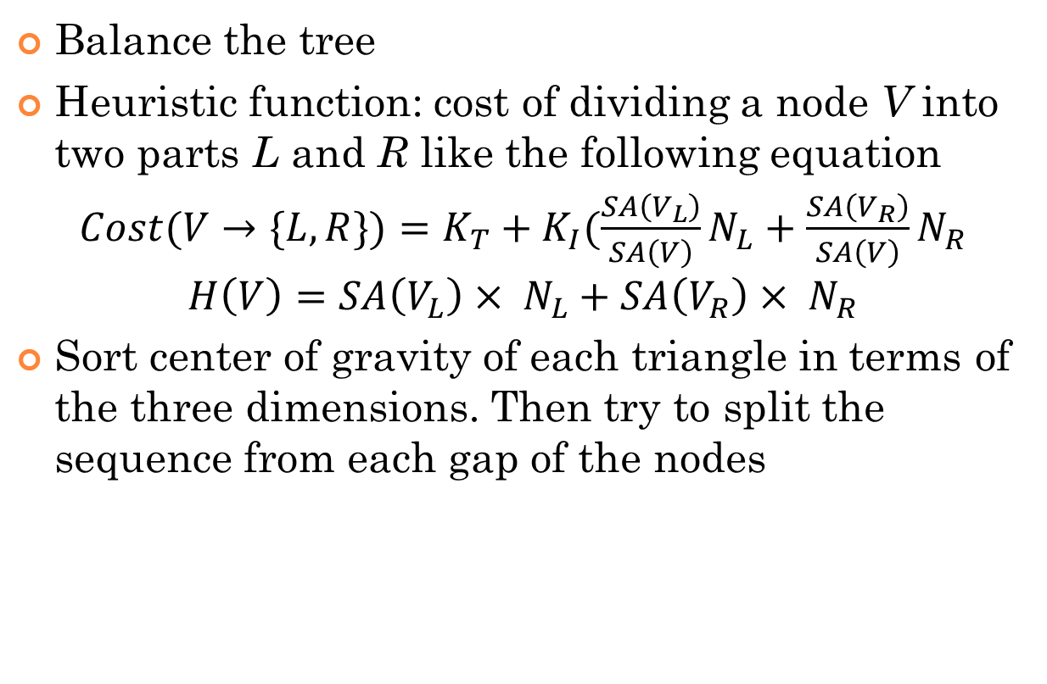
SAH-Based BVH
Balance the tree
Heuristic function: cost of dividing a node V into two parts L and R like the following equation
$Cost(V→\{L,R\})=K_{T}+K_{I}(\frac{SA\left(V_{L}\right)}{SA\left(V\right)}N_{L}+\frac{SA\left(V_{R}\right)}{SA\left(V\right)}N_{R}$
$$H\left(V\right)=SA\left(V_{L}\right)× N_{L}+SA\left(V_{R}\right)× N_{R}$$
Sort center of gravity of each triangle in terms of the three dimensions. Then try to split the sequence from each gap of the nodes

Slide 11
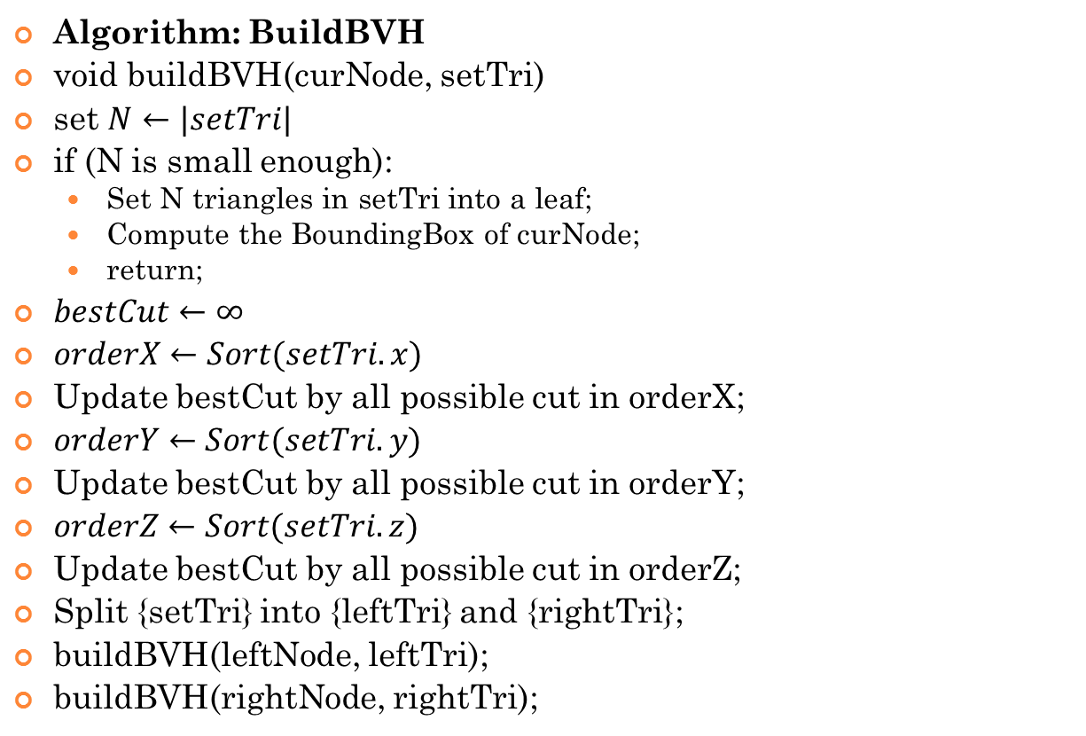
SAH-Based BVH
Algorithm: BuildBVH
void buildBVH(curNode, setTri)
set $N←|setTri|$
if (N is small enough):
Set N triangles in setTri into a leaf;
Compute the BoundingBox of curNode;
return;
$bestCut←∞$
$orderX←Sort(setTri.x)$
Update bestCut by all possible cut in orderX;
$orderY←Sort(setTri.y)$
Update bestCut by all possible cut in orderY;
$orderZ←Sort(setTri.z)$
Update bestCut by all possible cut in orderZ;
Split {setTri} into {leftTri} and {rightTri};
buildBVH(leftNode, leftTri);
buildBVH(rightNode, rightTri);

Slide 12
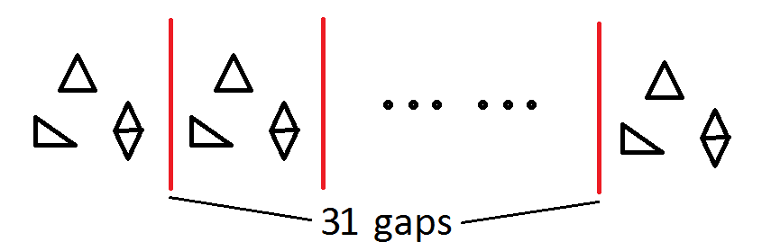
Building a BVH - Approximation
Most calculations appear in numerating the cut plains and making partition in all three dimensions, and hard to parallel
Approximation
Ingo Wald. On fast Construction of SAH-based Bounding Volume Hierarchies.
Cut the triangles into 32 groups evenly according to their coordinate value

Slide 13
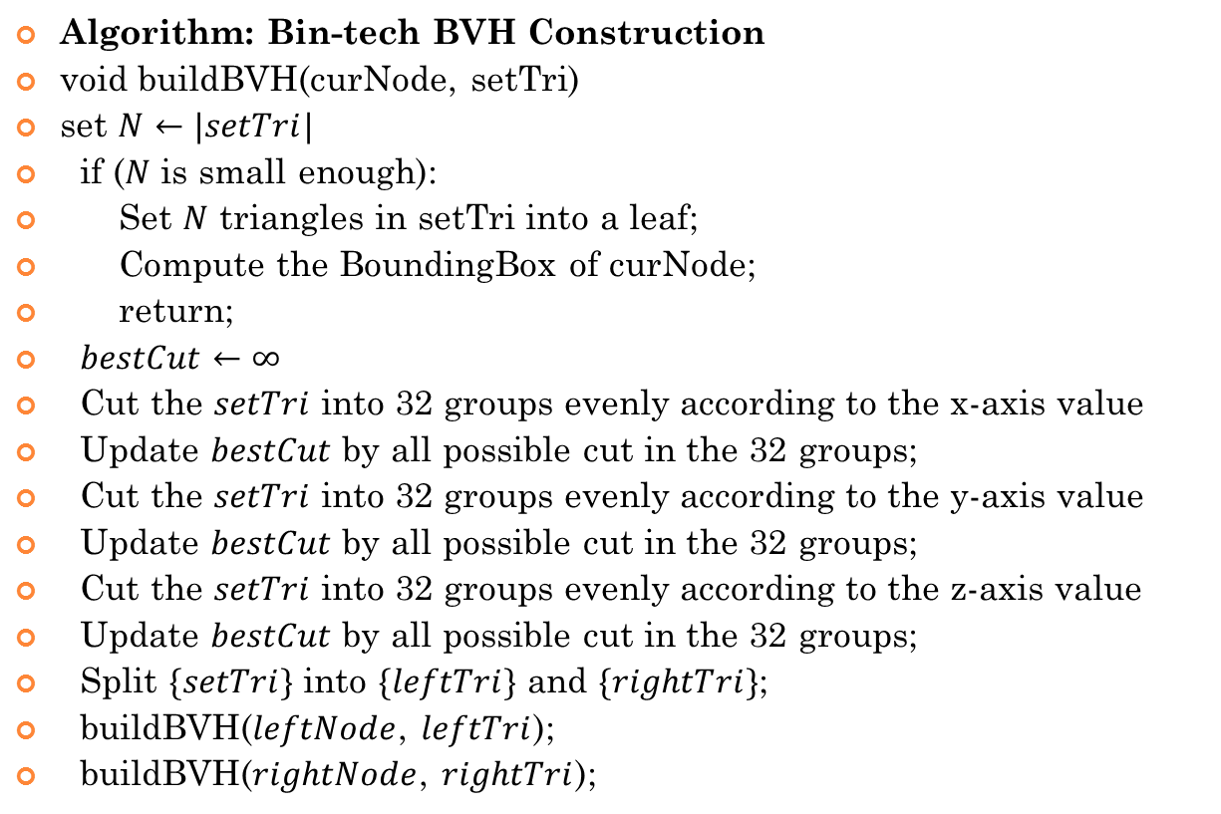
Build a BVH – Pseudo-code
Algorithm: Bin-tech BVH Construction
void buildBVH(curNode, setTri)
set $N←|setTri|$
if ($N$ is small enough):
Set $N$ triangles in setTri into a leaf;
Compute the BoundingBox of curNode;
return;
$bestCut←∞$
Cut the $setTri$ into 32 groups evenly according to the x-axis value
Update $bestCut$ by all possible cut in the 32 groups;
Cut the $setTri$ into 32 groups evenly according to the y-axis value
Update $bestCut$ by all possible cut in the 32 groups;
Cut the $setTri$ into 32 groups evenly according to the z-axis value
Update $bestCut$ by all possible cut in the 32 groups;
Split $\{setTri\}$ into $\{leftTri\}$ and $\{rightTri\}$;
buildBVH($leftNode$, $leftTri$);
buildBVH($rightNode$, $rightTri$);

Slide 14
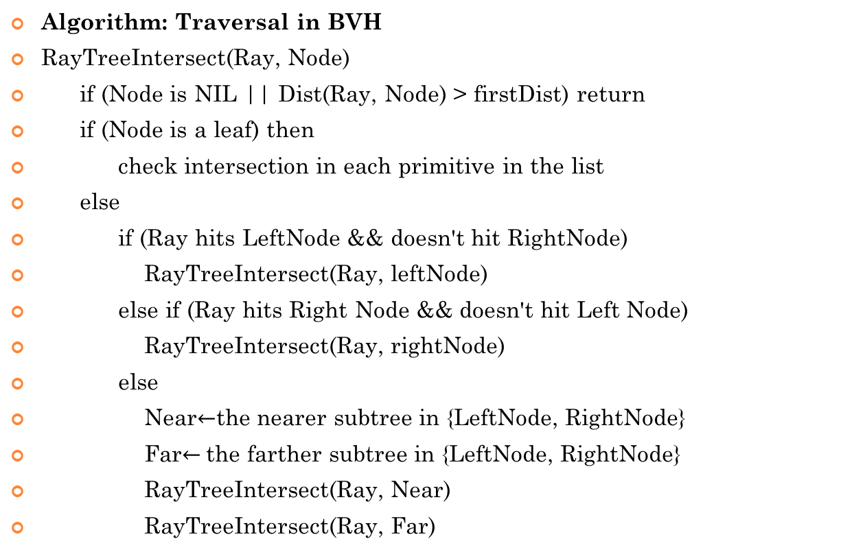
Ray Tracing - Traversal in BVH
Algorithm: Traversal in BVH
RayTreeIntersect(Ray, Node)
if (Node is NIL || Dist(Ray, Node) > firstDist) return
if (Node is a leaf) then
check intersection in each primitive in the list
else
if (Ray hits LeftNode && doesn't hit RightNode)
RayTreeIntersect(Ray, leftNode)
else if (Ray hits Right Node && doesn't hit Left Node)
RayTreeIntersect(Ray, rightNode)
else
Near$←$the nearer subtree in {LeftNode, RightNode}
Far$←$the farther subtree in {LeftNode, RightNode}
RayTreeIntersect(Ray, Near)
RayTreeIntersect(Ray, Far)

Slide 15
Build a BVH – Parallelism
Parallel invoke
cilk_spawn
buildBVH(leftNode, leftTri);
buildBVH(rightNode, rightTri);
cilk_sync;
Parallel bucket sort
For each Processor Do
Compute the information (number, bounding box) of each bucket separately in disjoint sets
Combine the information of different processors together
For each Processor Do (Optional)
Put the triangles into their positions separately

Slide 16
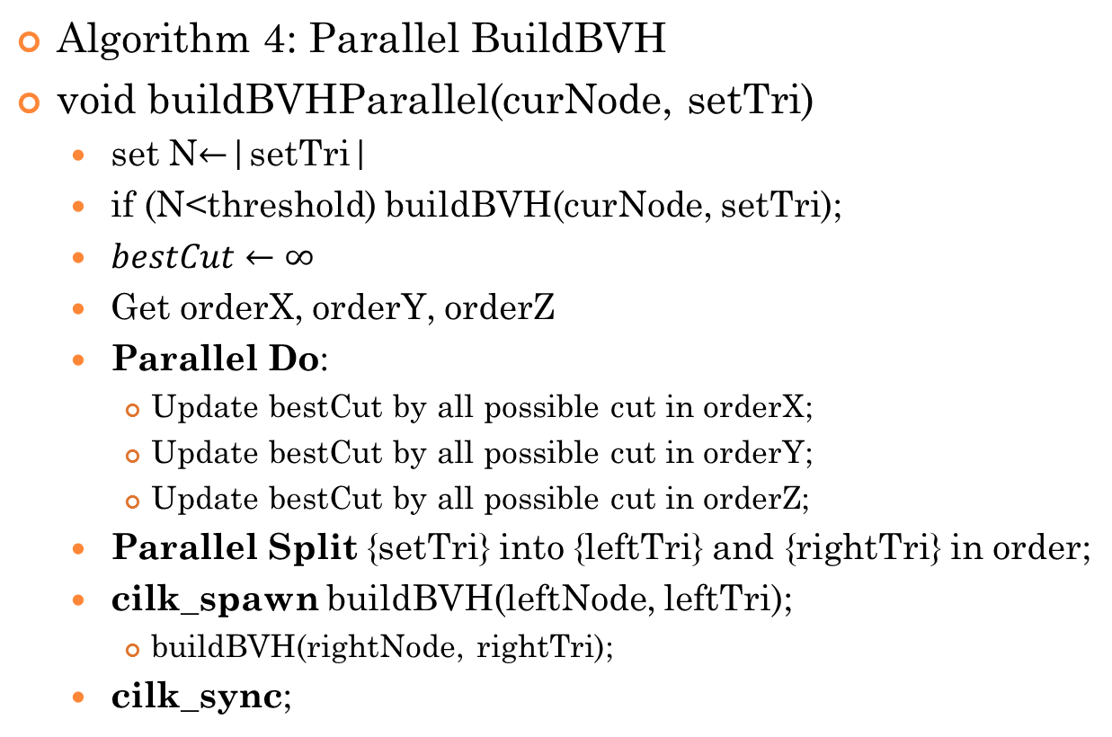
Build a BVH – Parallelism
Algorithm 4: Parallel BuildBVH
void buildBVHParallel(curNode, setTri)
set N$←$|setTri|
if (N<threshold) buildBVH(curNode, setTri);
$bestCut←∞$
Get orderX, orderY, orderZ
Parallel Do:
Update bestCut by all possible cut in orderX;
Update bestCut by all possible cut in orderY;
Update bestCut by all possible cut in orderZ;
Parallel Split {setTri} into {leftTri} and {rightTri} in order;
cilk_spawn buildBVH(leftNode, leftTri);
buildBVH(rightNode, rightTri);
cilk_sync;

Slide 17
Result
Model from: http://graphics.stanford.edu/data/3Dscanrep/
For building a BVH
model name | number of triangles | sequencial | paralleled | speed-up
Crytek Sponza | 132267 | 1.574948 | 0.355206 | 4.4339
Chinese Dragon | 871306 | 11.75276 | 2.399263 | 4.898489
Happy Buddha | 1087474 | 15.11632 | 3.479823 | 4.34399

Slide 18
Result
Model from: http://graphics.stanford.edu/data/3Dscanrep/
For building a BVH
model name | number of triangles | sequencial | paralleled | speed-up
Crytek Sponza | 132267 | 1.574948 | 0.355206 | 4.4339
Chinese Dragon | 871306 | 11.75276 | 2.399263 | 4.898489
Happy Buddha | 1087474 | 15.11632 | 3.479823 | 4.34399

Slide 19
Result
For ray tracer:
model name | resolution | focal length | g++ | openmp | cilk++, 1 thread | cilk++, 4 threads
car | 800*600 | 6mm | 3.212083 | 1.877977 | 11.0706 | 3.29703
car | 800*600 | 13mm | 9.91627 | 5.761973 | 34.19067 | 9.860459
combo | 800*600 | 6mm | 35.72907 | 19.93217 | 117.8203 | 33.05656
combo | 800*600 | 13mm | 48.44558 | 27.7024 | 162.4477 | 48.5733
head | 1920*1080 | 6mm | 62.55285 | 34.93843 | 204.5045 | 56.2839
head | 1920*1080 | 13mm | 56.98803 | 31.9601 | 183.5668 | 52.18083

Slide 20
Result
For ray tracer:
model name | resolution | focal length | g++ | openmp | cilk++, 1 thread | cilk++, 4 threads
car | 800*600 | 6mm | 3.212083 | 1.877977 | 11.0706 | 3.29703
car | 800*600 | 13mm | 9.91627 | 5.761973 | 34.19067 | 9.860459
combo | 800*600 | 6mm | 35.72907 | 19.93217 | 117.8203 | 33.05656
combo | 800*600 | 13mm | 48.44558 | 27.7024 | 162.4477 | 48.5733
head | 1920*1080 | 6mm | 62.55285 | 34.93843 | 204.5045 | 56.2839
head | 1920*1080 | 13mm | 56.98803 | 31.9601 | 183.5668 | 52.18083

Slide 21
Thank You!
Q&A

